Slide 1

VIRTUAL HEALTH ASSISTANT

Slide 2
Aim of the presentation
It is important the solution is easy-to-use to properly enjoy what it has to offer. To serve the purpose, this presentation is meant to properly show, analyze the working process and demonstrate the usage of the solution

Slide 3
Introduction
Recall that it was stated in the documentation that there are some existing technological innovations such as TeleHealth and Web Service Healthcare Consumerism e.t.c.
But the beauty of Technology is IMPROVEMENT of which inspired the team to bring up a solution that is much more handy – A Virtual Health Assistant that is very interactive and diagnostic.

Slide 4
Aim and Objectives of the solution
The aim of this project is to replicate a person’s discussion - implement a conversational system that is as close to human interaction as possible such that a user sends input and receives response.
To create a chat bot that serves a vast amount of known medical facts regarding diseases, symptoms, disease patterns, risk criteria, etc. in a Question and Answer interface.
Reduce the cost of Healthcare organizations.

Slide 5

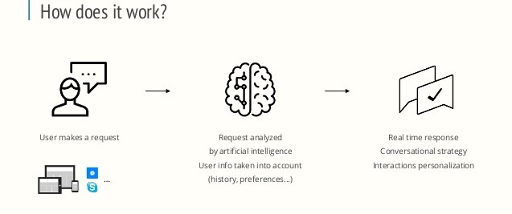
Working functionality of the solution
Access solution here: https://github.com/DeleMike/Virtual-Health-Assistant

Slide 6
As it stands …
Due to the dataset challenge the Team faced (took too long before getting the one we wanted) with limited timeframe for solution submission, The team could not finish the solution as planned.

Slide 7
The Good news! – What the team has achieved
The team has successfully added the model file, the code for the API server that the Android will be taking responses from, to the GitHub repository: https://github.com/DeleMike/Virtual-Health-Assistant
So anyone that runs the code will have a server running already with the model. All that is left to do is for the Android interface of the model to make use of the API server.

Slide 8
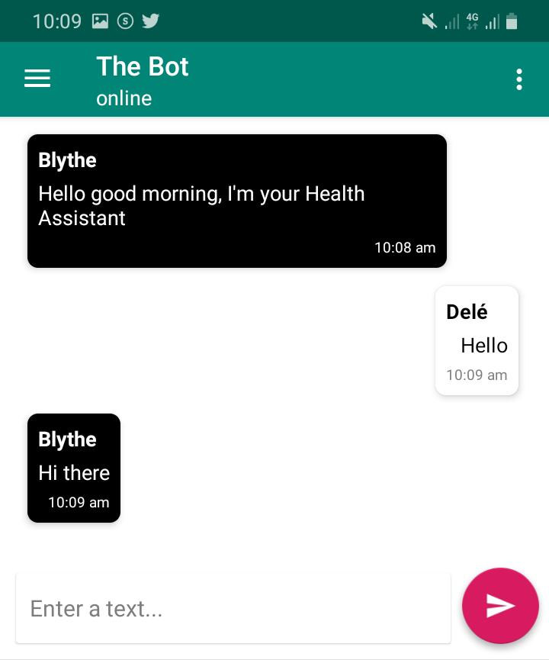
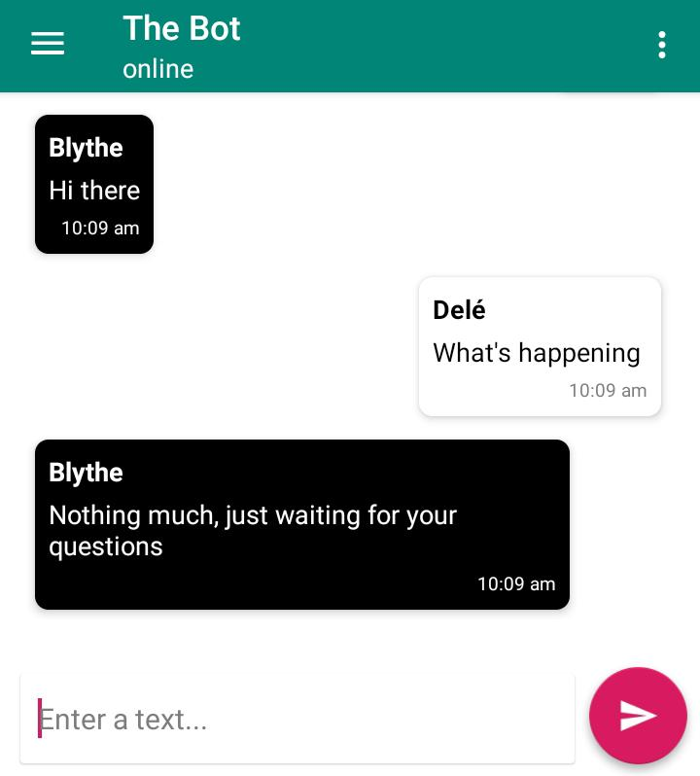
Picture demonstration
Screenshots of the Android User Interface (not currently taking responses from the server).
As previously mentioned, All that is left for this interface of the model is to make use of the API server.

Slide 9
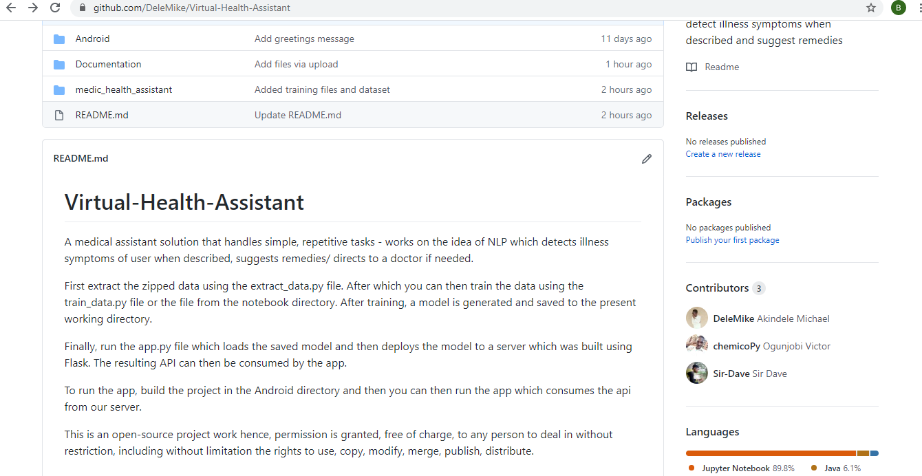
Since the solution has not been completed, Here is a picture of how to run, complete and use the solution. It can be found in the README file.

Slide 10
Future Plans of the Team on the solution
Our current solution will be deployed on Android and requires internet to access the API.
But the future plan of the team is that: Alongside improving the chatbot to work on generative model approach to make it super intelligent, the on-device chatbot will require no connectivity to the internet or server.

Slide 11
Conclusion
Our idea behind this study is to present sophisticated AI medical chatbots for users, especially during unknown pandemics like COVID-19. The presented AI chatbot will have a large impact on patient life during serious epidemics. It would provide the advantage of putting access to virtual doctors or medical personnel into their hands. We bring health specialists and professionals into our platform to feed medical information into a bot engine, also to the availability of every user whenever the possibility of infection is detected.
To note:
Even though AI systems learn from accurate, representative data, there can still be problems if that information reflects underlying biases and inequalities in the health system.
A hopeful vision is that providers will be thrilled and enabled to provide more-personalized and better care!.

Slide 12
Thank You!.

